Slide 1
Digital Twins
What is a Digital Twin?
A digital twin (DT) is a virtual representation that serves as the real-time digital counterpart of a physical object or process.
The first practical definition of DT originated from NASA in an attempt to improve the physical model simulation of a spacecraft in 2010.
The vision for DTs is to provide a comprehensive physical and functional description of a component, product, or system
The first and most important step is to create high-fidelity virtual models to realistically reproduce the geometries, physical properties, behaviors, and rules of the physical world

Slide 2
Digital Twins
Functional Implementation of DT
The DT integrates whole elements, the entire business, and the process data to ensure consistency
DT enables manufacturers to make more accurate predictions, rational decisions, and informed production
The main idea of a DT is to create a digital copy (i.e., virtual models) for physical entities in order
to simulate and reflect their state and behaviors through modeling and simulation analysis
to predict and control their future states and behaviors through feedback
models and data can be considered as the core elements of a DT.

Slide 3
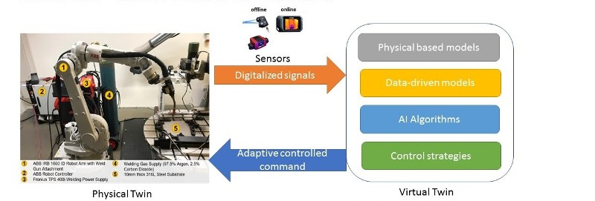
three important parts in the digital twin :
• a model of the object,
• an evolving set of data relating to the object, and
• a means of dynamically updating or adjusting the model in accordance with the data.
The virtual twin will be used to detect the printing failure and further optimize the additive manufacturing processes

Slide 4
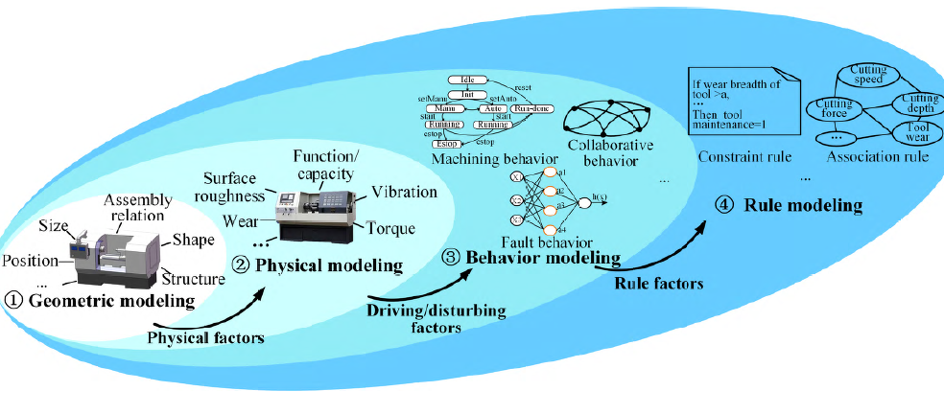
Digital Twins

Slide 5
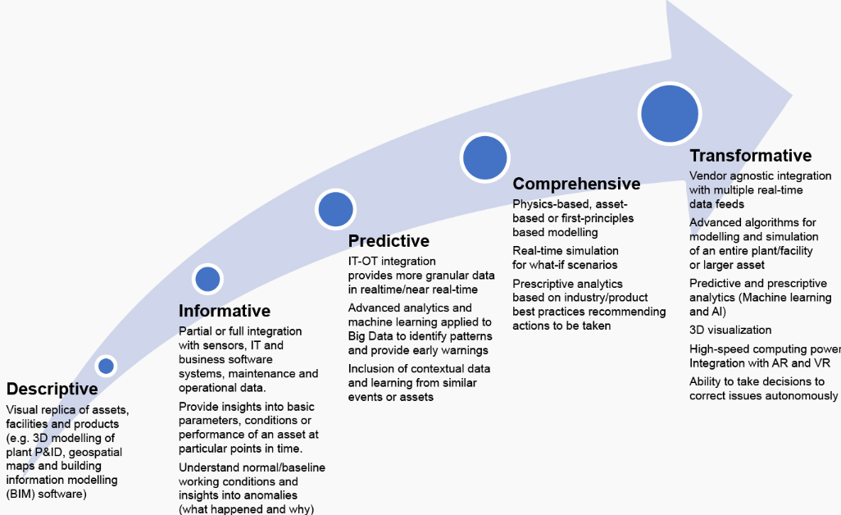
Digital Twins
Five levels of Digital Twins
2 D and 2 P Analytics
Descriptive (existing reference model),
Diagnostic (what's happening and Why
did it happen?)
Predictive (what will happen?) Prescriptive (what should be done?).
https://www.verdantix.com/newsroom/press-releases/verdantix-says-that-digital-twins-operate-at-five-different-levels-of-sophistication

Slide 6
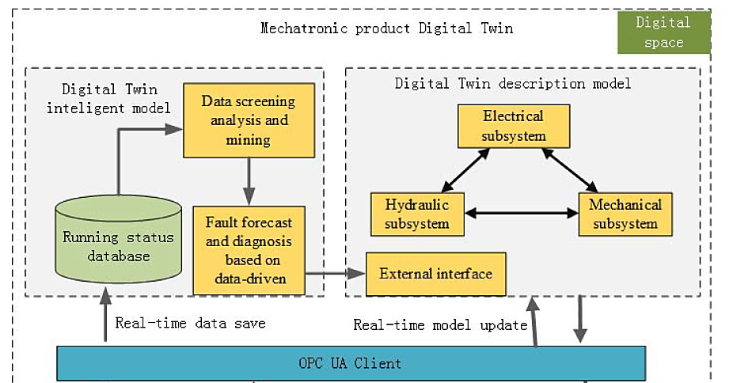
Five levels of Digital Twins
Level 1: Descriptive Twin
It isa live, editable version of design data—a visual replica of a built asset. Users specify what kind of information they want to be included
describes the geometric, physical characteristics and governing equations of each subsystem of CNC M/c.

Slide 7
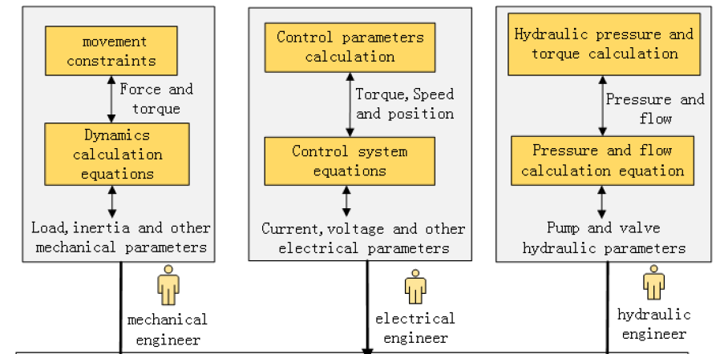

Slide 8
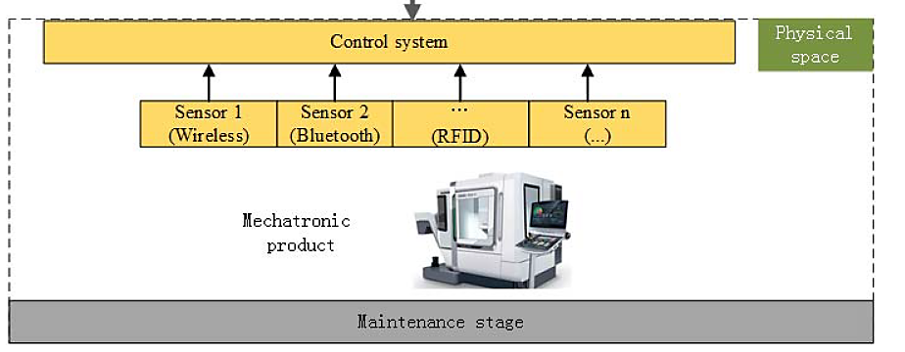
Five levels of Digital Twins
Level 2: Informative Twin
This level has an added layer of operational and sensory data. The twin captures and aggregates defined data and verifies data to make sure that systems work together.
In CNC, the device’s running status are gathered to control system by different type of sensors such as temperature sensor, pressure sensor, velocity etc.,

Slide 9
Five levels of Digital Twins
Level 3: Predictive Twin This twin can use operational data to gain insights through advanced Analytics and machine learning- to identify patterns or behavior
The DT intelligent model stores, analyzes the running status data and fault diagnosis is done using machine learning

Slide 11
Level 4: Comprehensive Twin
This twin simulates future scenarios and considers “what-if” questions.
Prescriptive Analytics based on Industry best practices
Level 5: Autonomous Twin
This twin has the ability to learn and act on behalf of users.

Slide 12
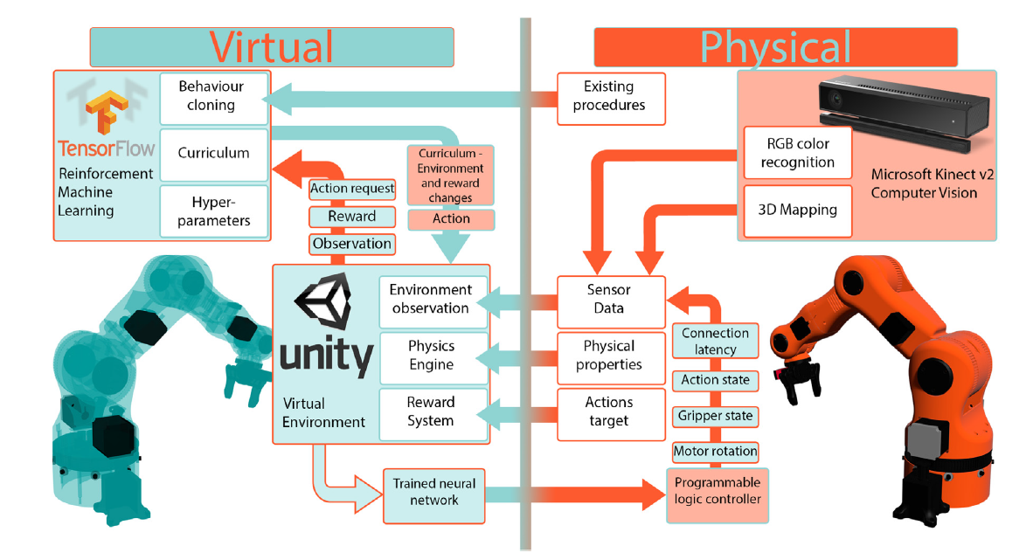
Digital Twins- Examples for Informative, Predictive & Comprehensive levels
Predictive
Informative
Comprehensive
Predictive

Slide 13


Digital Twins
Types of Digital Twins
1. Asset twins
When two or more components work together, they form what is known as an asset.
Asset twins let you study the interaction of those components, creating a wealth of performance data that can be processed and then turned into actionable insights.
2. System twins
The next level of magnification involves system twins, which enable you to see how different assets come together to form an entire functioning system.
System twins provide visibility regarding the interaction of assets, and may suggest performance enhancements.

Slide 14

Digital Twins
3. Process twins
Process twins reveal how systems work together to create an entire production facility. Are those systems all synchronized to operate at peak efficiency, or will delays in one system affect others?
Process twins can help determine the precise timing schemes that ultimately influence overall effectiveness.

Slide 15
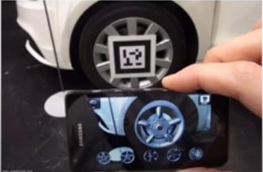
Augmented Reality
Types of AR
MARKER or Target-based AR
It is tied to a specific physical image pattern marker in a real-world environment to superimpose the virtual 3D object, text, or animation on top of it.
The cameras continuously scan the input and put a mark for image pattern recognition to create its geometry.
When the camera is not focused on a particular spot, the virtual 3D object is not shown properly.

Slide 16
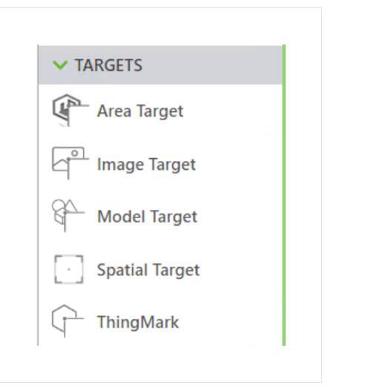
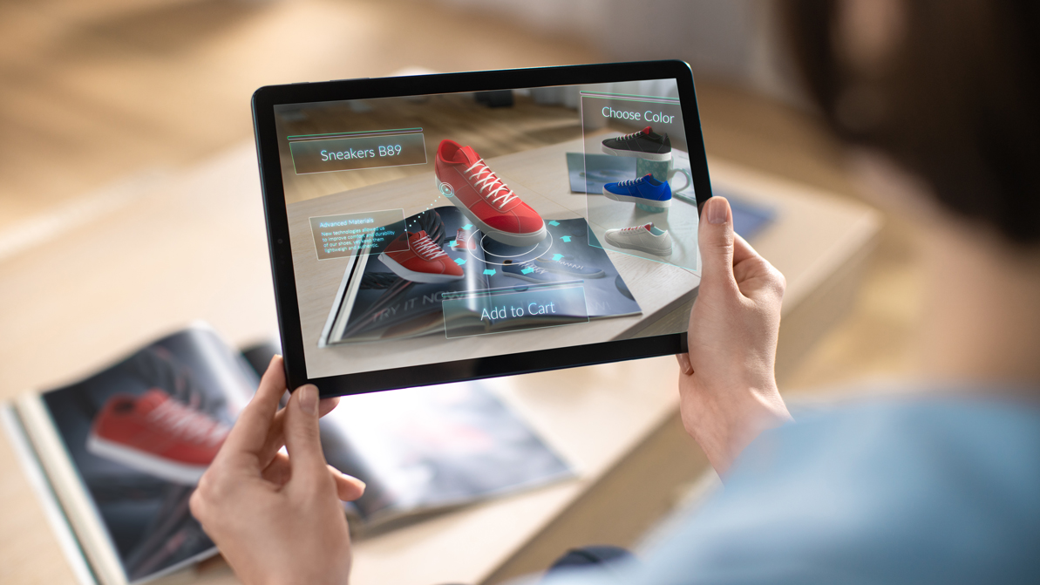

Slide 17
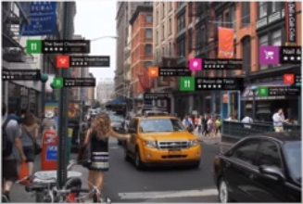
MARKERless AR
2. 1 Location
It refers to the software application that does not require any camera to put a mark for image pattern recognition.
Markerless AR places virtual 3D objects in the real-life environment by examining the features present in the real-time data.
It relies on the hardware of any smartphone including the camera, GPS, digital compass, and accelerometer for the AR software to complete the work efficiently.

Slide 18

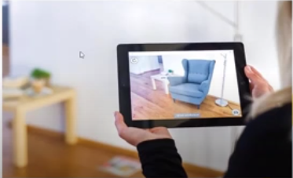
2.2 Projection based AR
It is a method of delivering digital data within a stationary context
uses SLAM to detect human interaction with the augmentation
the fixed projector and a camera are placed for tracking .
the projection-based AR can be used to create holograms
2.3 Superimposition-based AR
It is used either for partial or full replacement of the original view of an object with an updated augmented view of that object for the human eye.
Superimposition AR provides multiple views of a target object with the option of showing extra relevant information on that object.

Slide 19
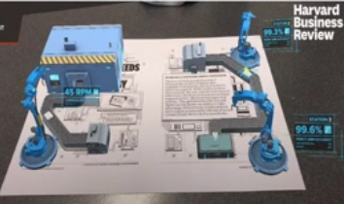
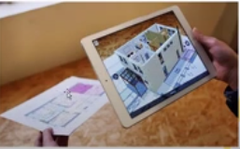
Augmented Reality
Applications of AR
Process Industries
If a supervisor needs to inspect a production line, he needs to physically visit the production line and each and every station present in the production line.
With AR and merging IoT to AR, actions and performance of the stations can be inspected from his/her desk itself
2. Civil / Architecture
Understanding building plans are sometimes difficult.
Using AR, subjecting a tab or a mobile device to the plan of a building will show the model of the building based on the plan on the screen

Slide 20
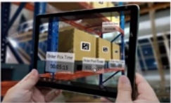
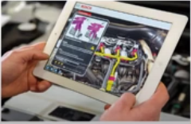
Augmented Reality
3. Supply chain
The supervisor in a warehouse need not walk around and check for the details of the packages in the warehouse manually
By scanning the QR code on the package, the details about the package will be available on the mobile/tablet screen
4. Service Industry
Can be used to give proper instructions on how to service a part of an automobile.
The service personnel will show the camera of a mobile or a tablet to an engine part
Details of the part will be populated on the screen of the tablet along with instructions on how to service

